Slide 1


1

Slide 2
Welcome
Save & Safety and Rapidly
Welcome Judges
StreamLine
2

Slide 3
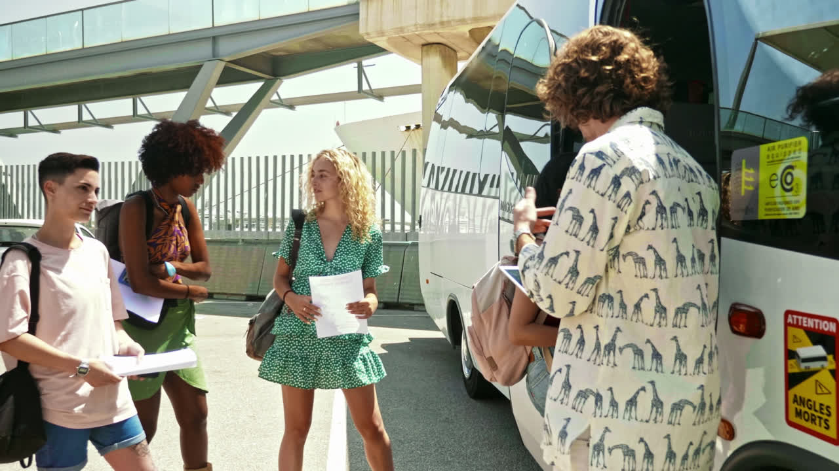
Target Audience
Target Audience
Budget Travelers
Cultural Tourists
Business Travelers
Family Vacationers
3

Slide 4


Problem
Poor tourism knowledge
over budget
Problem
Misuse of time and money
Lack of student internship
4

Slide 5
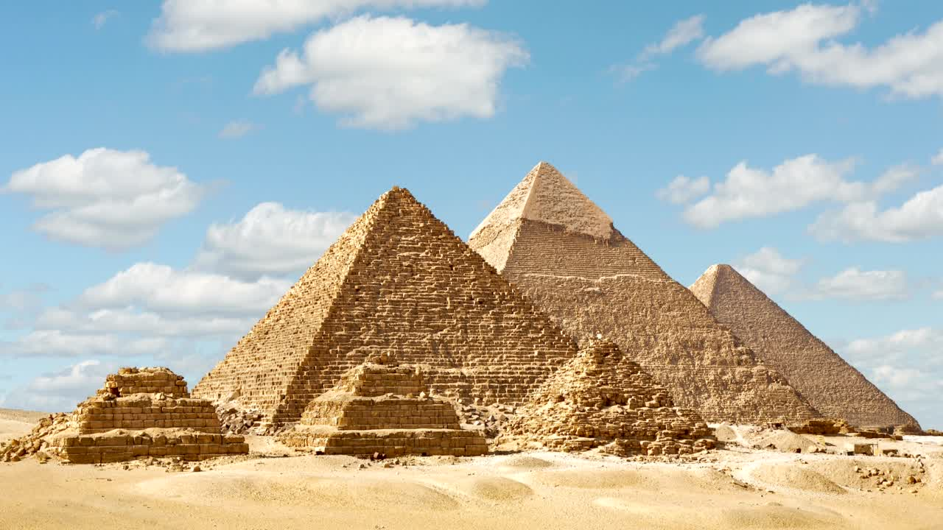
Solution
Solutions
AI-based recommendations
Budget planning tools
Efficient itinerary planner and cost
Multiple packages
Free Student Internship
5

Slide 6
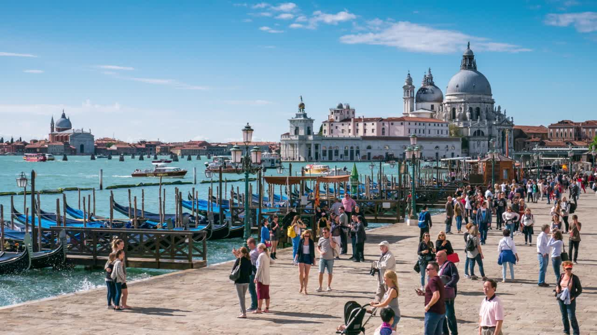
Key & Value
Cost-Effectiveness
Localized Content
Support and Trust
Health insurance
Convenience in Planning
Key & Value
6

Slide 7
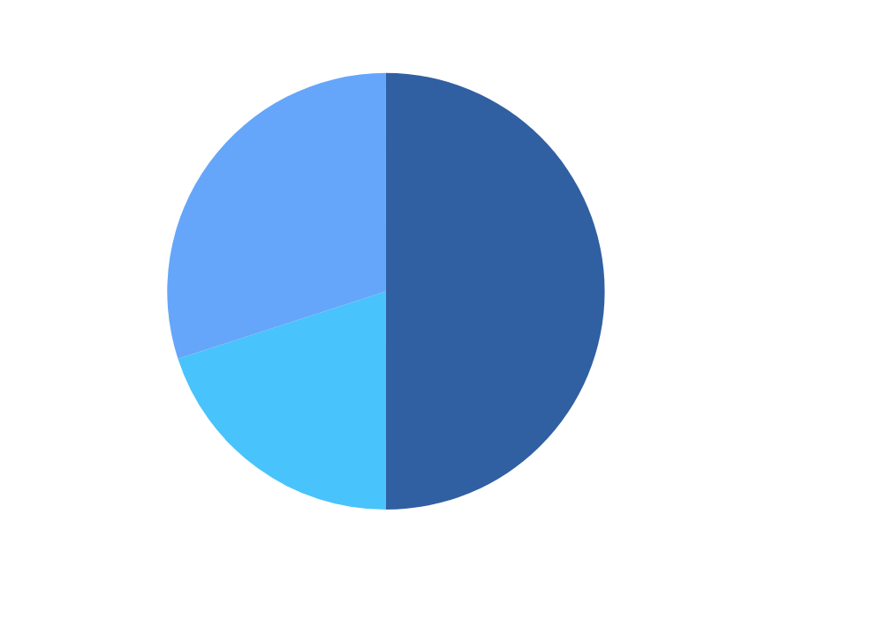
Funding
Platform development :
Programmer salaries
API key
Operations and support :
Funding
Customer service
Tour guide salaries
Marketing efforts :
The influencers
Social media Ads
7

Slide 8

Growth Stratege
Phase 1
Phase 2
Local market penetration
Regional Expansion
Growth Stratege
Phase 3
8
Global Scalingon

Slide 9
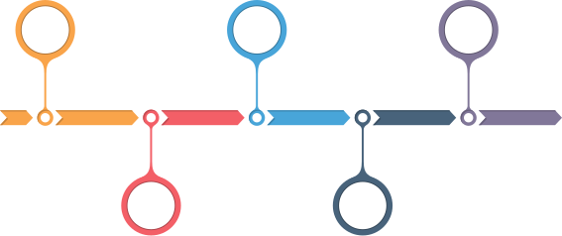
Timeline
Design
Feedback
Future Plan
Timeline
Focus Group
Lunch
9

Slide 10
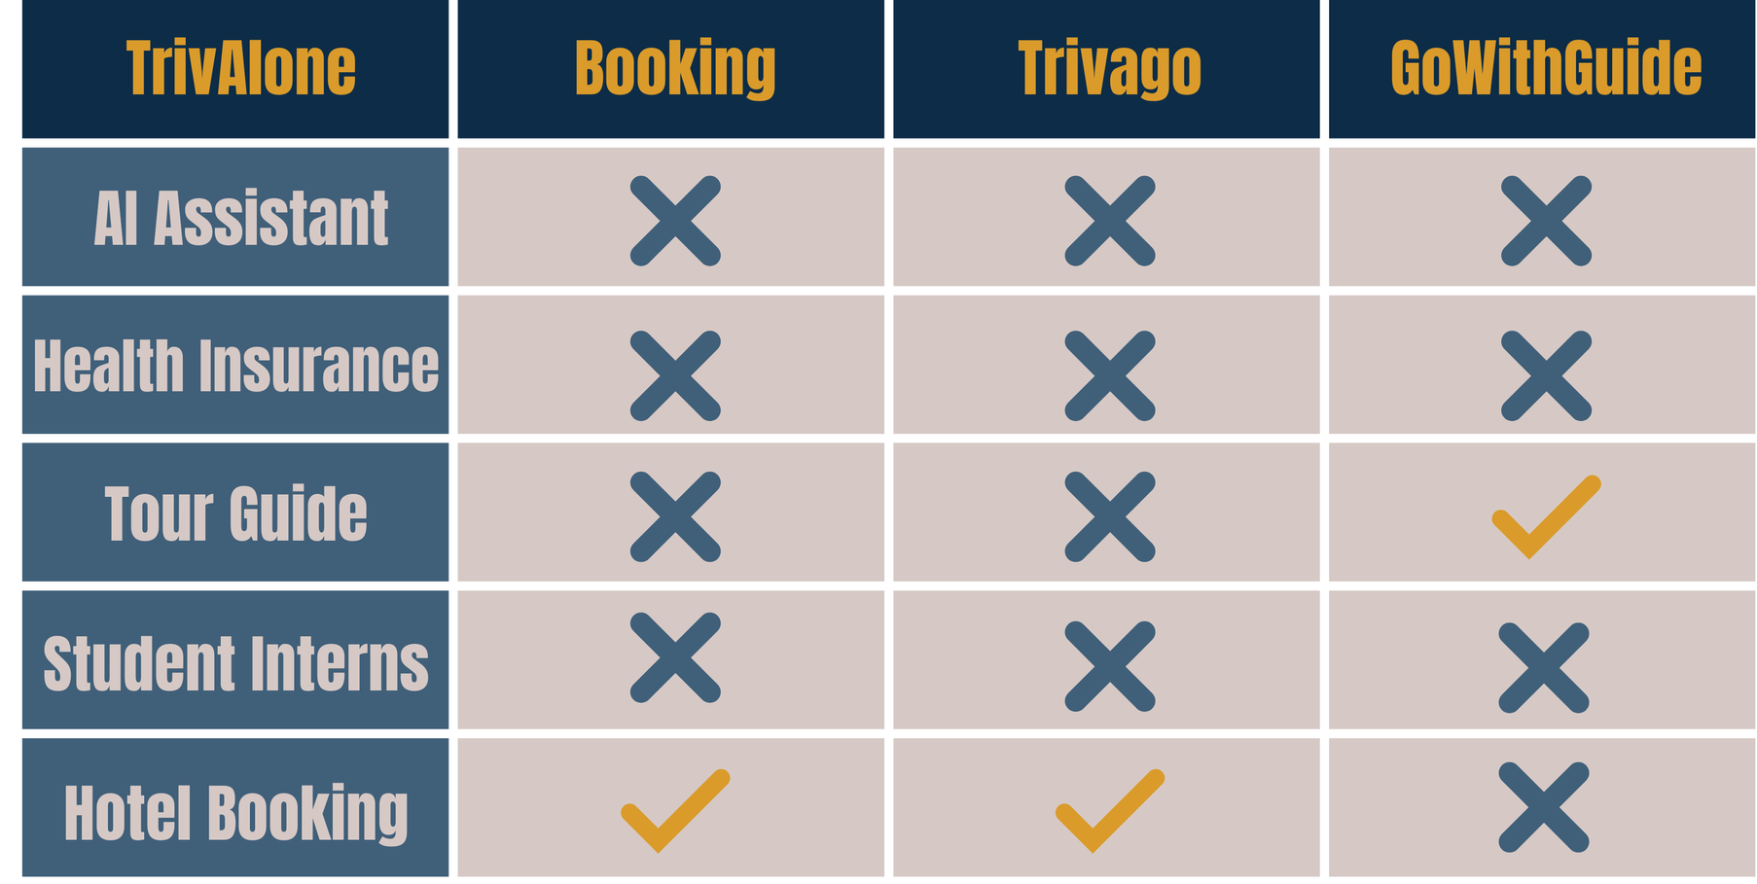
Market Research
Market Research
10

Slide 11
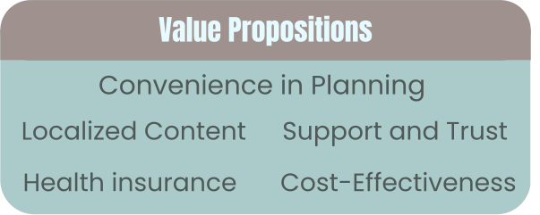
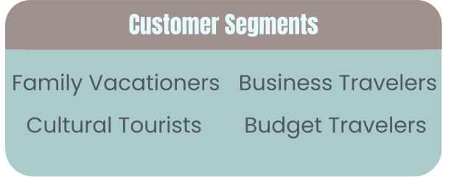
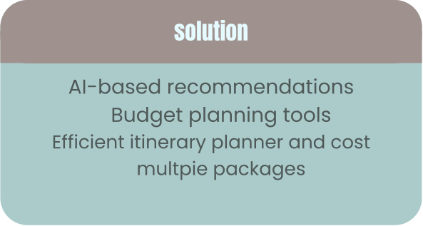
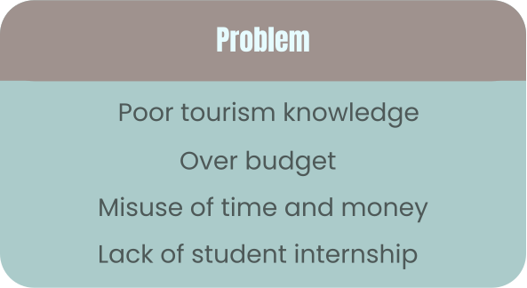
Business Model
Business Model
11

Slide 12
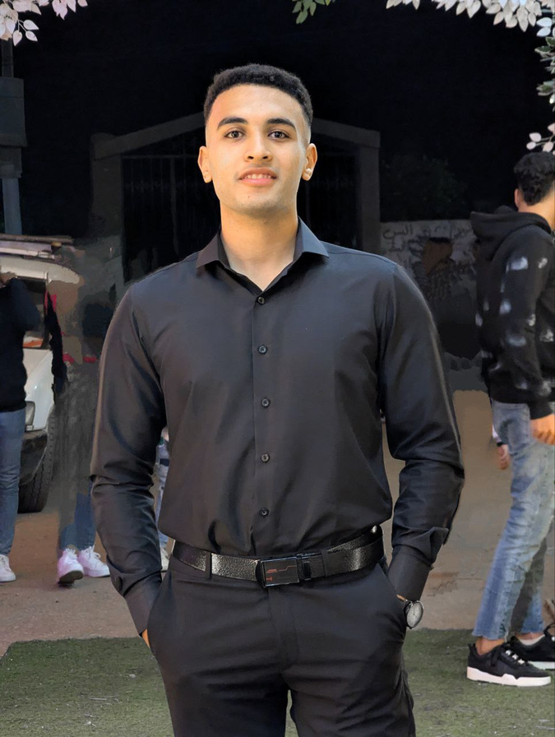
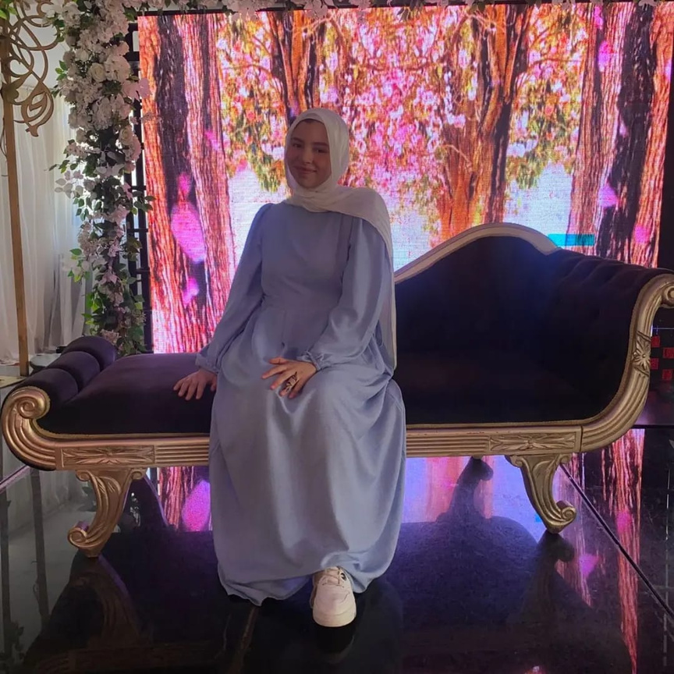
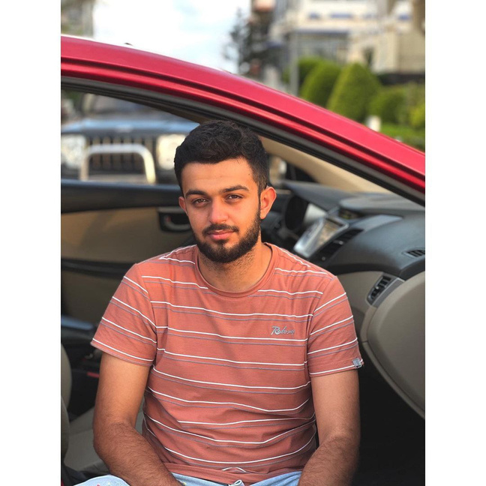
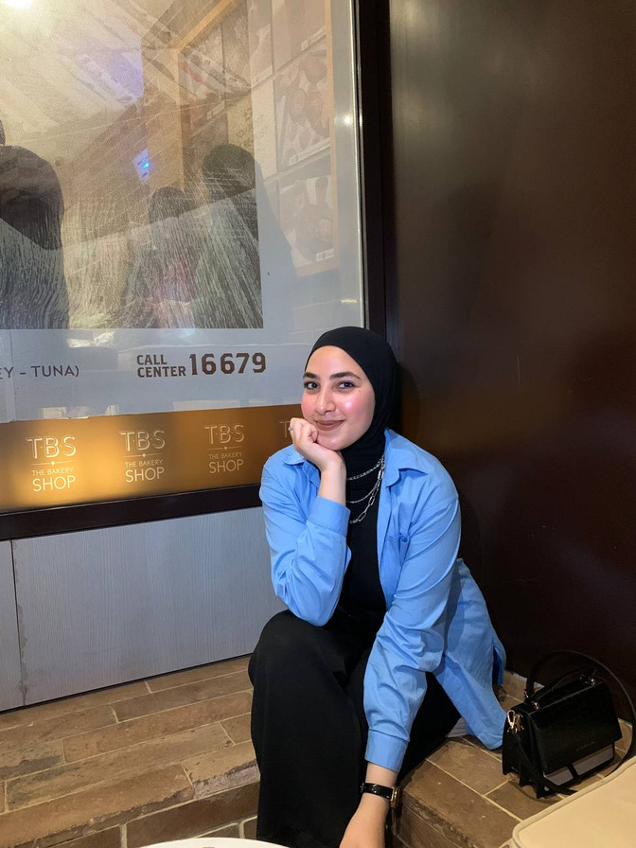
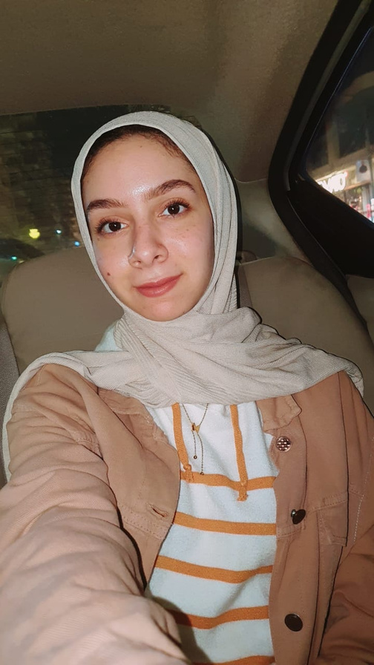
StreamLine
Mohamed Reda
Basmala Mohamed
Mohamed Ramy
About Us
Esraa Ahmed
Alaa Yasser
12

Slide 13
Resourses
https://www.qualtrics.com/experience-management
https://www.booking.com/
https://www.sciencedirect.com/journal/journal-of-business-research
https://www.viator.com/
https://chatgpt.com/
https://www.sciencedirect.com/science/article/abs/pii/S0024630113000502
13

Slide 14
Thanks for listening
Thanks
14

